Slide 1
VR ASSEMBLY OF AIRCRAFT
By
Manik Arrolla
Sri Teja B
olalekan

Slide 2
OUTLINE
Goals and Objectives
Software Required
Modeling

Slide 3
Goals & objectives
To assemble Aircraft in VR environment using Vizible.
Drag and drop interface in Vizible
Slide deck based presentation creation
Collaborative, multi-user editing of presentations
Built-in avatars(Presenter & Attendee)
Slide clicker for transitioning between parts of your presentation, just as you would with a PowerPoint presentation.

Slide 4
Software required
Vizible.
Vizard
Google Sketch up

Slide 5
Hardware Requirements
Minimum
Operating system: Windows 7, 8, 8.1, or 10 (requires a 64bit OS)
CPU: Intel™ Core™ i5-4590 or AMD FX™ 8350, equivalent or better
Memory: 4 GBGPU - GTX 1070
Hard drive: 1.8 GB free
Recommended
Operating system: Windows 10 64bit
CPU: Intel™ Core™ i7-4790K Memory - 16 GB
Graphics hardware: GTX 1080
Hard drive: 5.0 GB free
Audio: 7.1 Channel surround sound headset

Slide 6
About vizible
It is powerful VR creation and collaboration software.
With the help of vizible we can work Collaboratively.
We can do multi-user editing of presentations in a virtual platform.
Oculus and Vive are fully supported hardware.

Slide 7
Vizible featurs
Vizible Presentation Designer
Lay out configuration
Importing and editing content
Adding interactivity

Slide 8
How to Use the Desktop Menu
The directions for using the controls are on the screen. Use W S A D on the keyboard to move Up, Down, Left, and Right. Navigate through the menu using these keys and use Left Mouse button to select. Toggle the menu using Spacebar.
Note: Do Not click on the tiles with your mouse, rather, you must use W S A D to move to each tile in the menu and then left click your mouse to select.

Slide 9
Import assets
Creating 3d models on google SketchUp and creating them as dae file format.
Using Vizard inspector we can modify the 3d model and convert them into osgb file format.
Vizible uses Vizard as its underlying render engine to process and display 3D models. Vizard is an OpenGL platform which natively renders .osgb models, but accepts a wide range of model types.
Created 3d aircraft model using vizard
Assembled different components/parts of the aircraft in a step by step procedure.

Slide 10

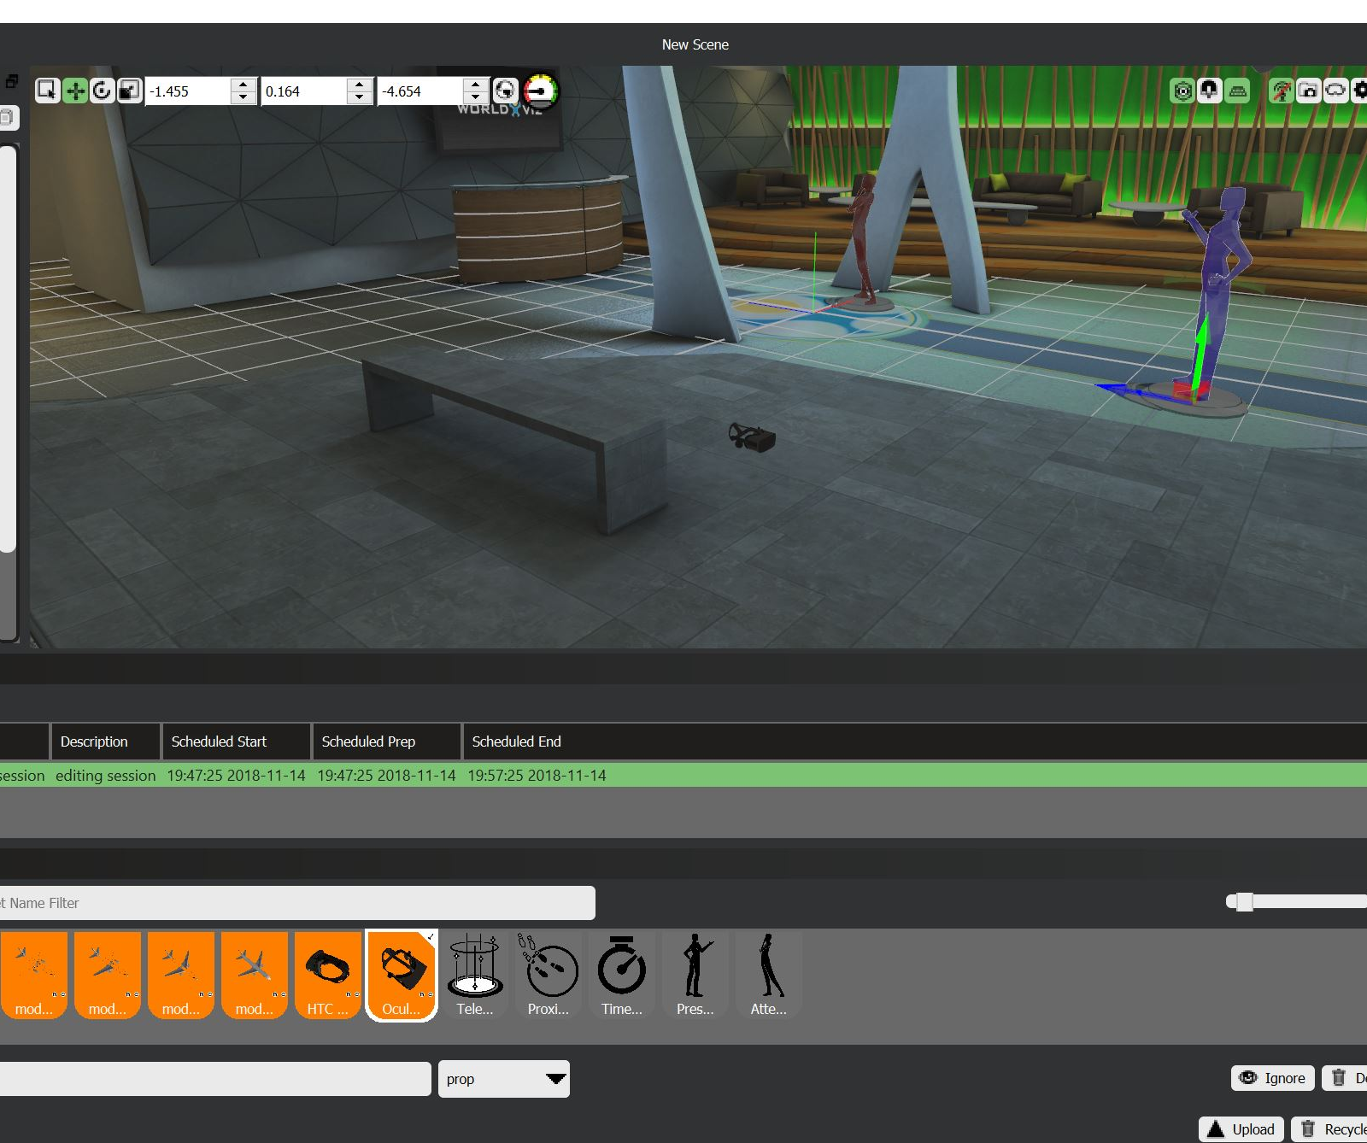
Presentation design
This is the first scene, The main lobby
Where the presenter and attendee are standing .
Oculus device is available.

Slide 11
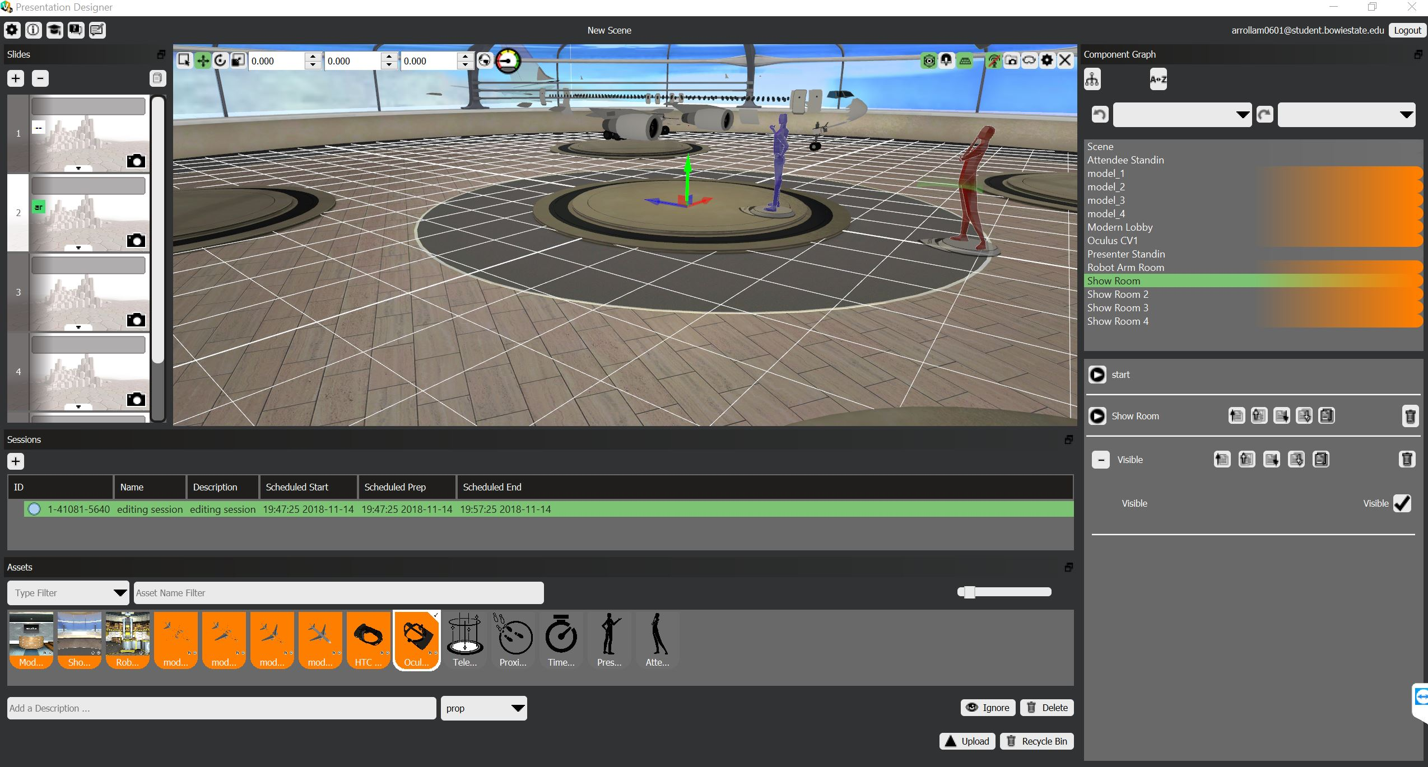
Presentation design(cont’d)
Second scene, The 3d aircraft skeleton is visible.

Slide 12

Presentation design(cont’d)
Third scene, The 3d aircraft skeleton is with left wing is visible.

Slide 13
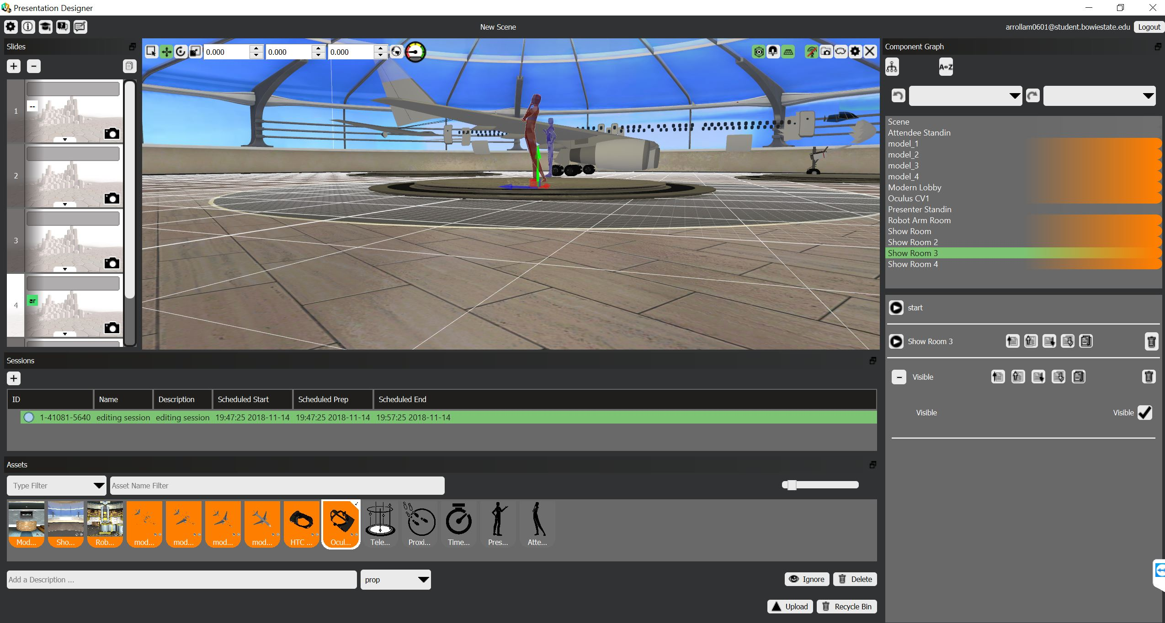
Presentation design(cont’d)
This scene, The 3d aircraft skeleton is with right wing is visible.

Slide 14
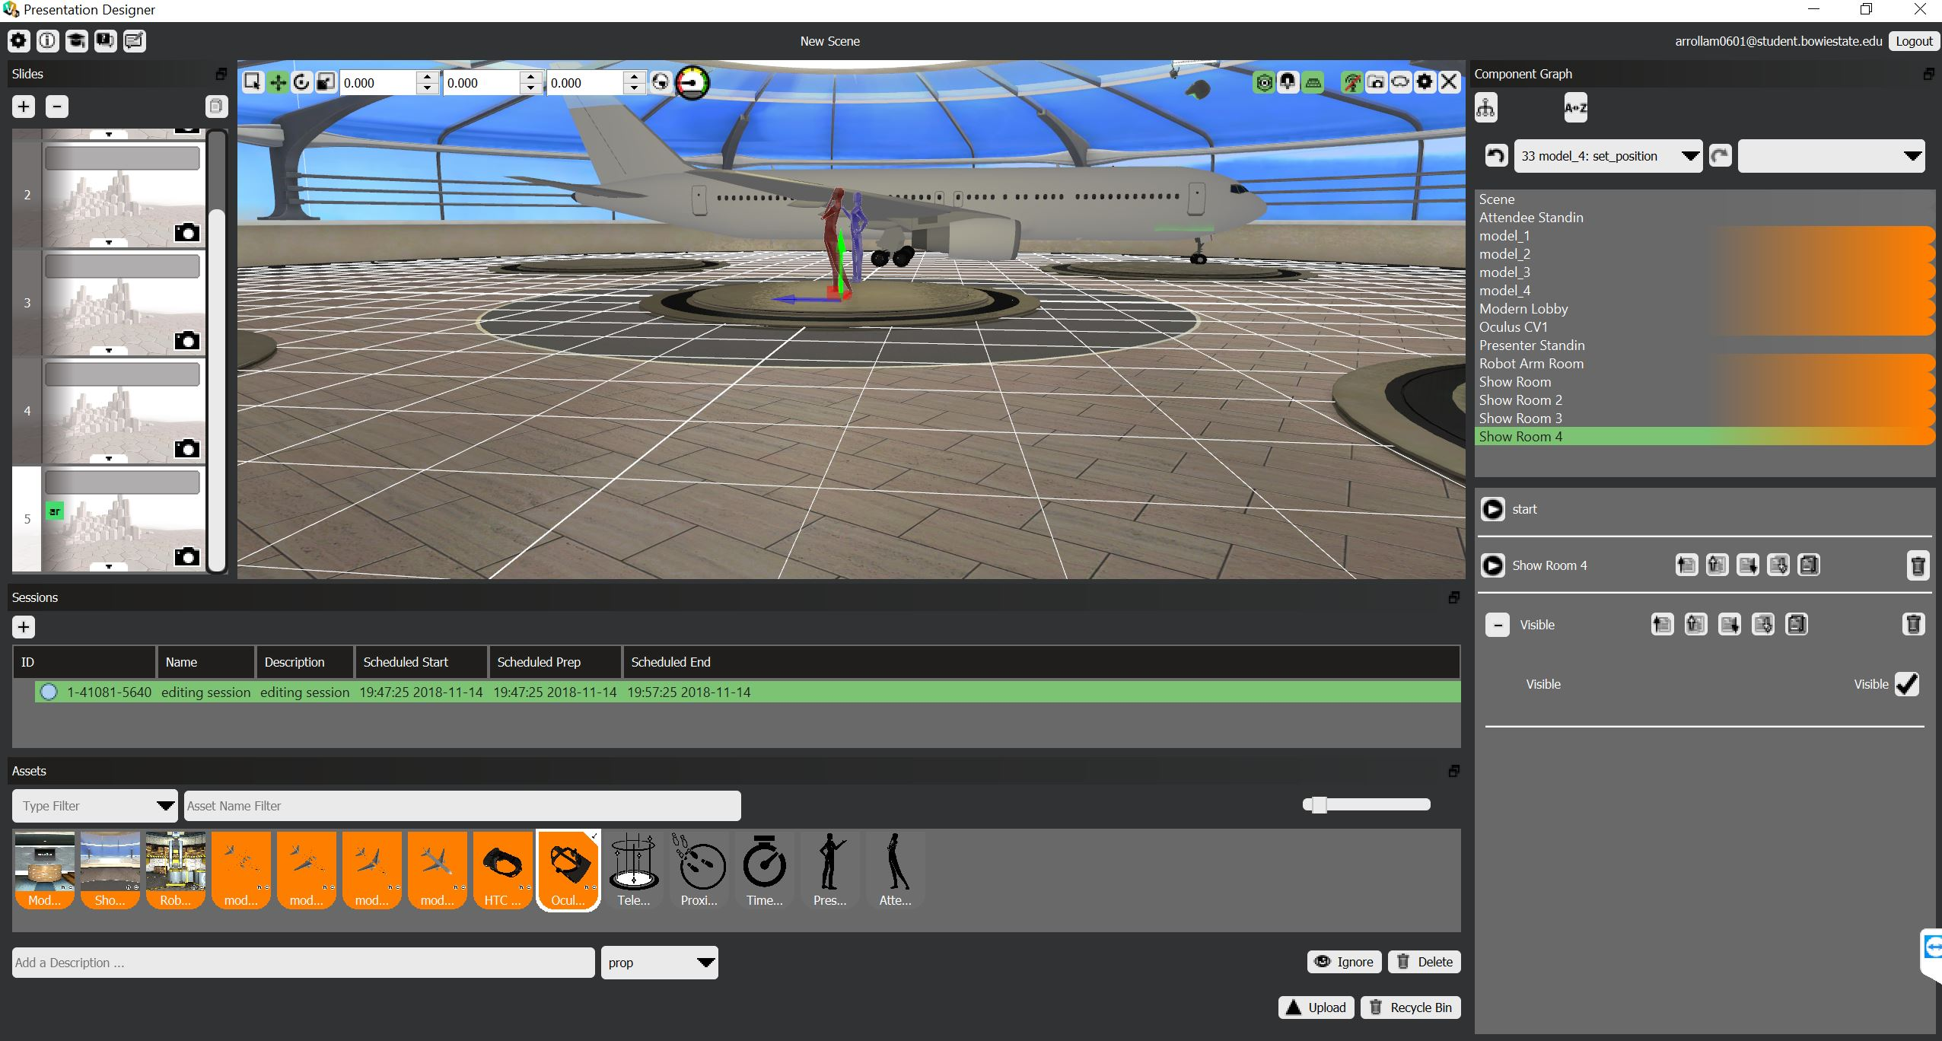
Presentation design(cont’d)
This scene, The 3d aircraft with full components is visible.

Slide 15
THANK YOU

